Slide 1
ROUND TABLE CONFERENCES (1930-1932)
Group Members:
Muhammad Junaid Shaikh (17k-3895)
Muhammad Mustafa Manga (17k-3795)
Murtaza Ali Hussain(17k-3886)

Slide 2
Contents:
Brief Introduction
Factors leading to Round Table Conferences
First Round Table Conference
Success and Failures of 1st RTC
Second Round Table Conference
Success and Failures of 2nd RTC
Third Round Table Conference
Success and Failures of 3rd RTC
Impacts of Round Table Conferences in India
Conclusion

Slide 3
BRIEF INTRODUCTION
What is a Round Table Conference?
Round Table is a form of academic discussion.
Each person given equal right to participate and speak.
“The three Round Table Conferences of1930-32 were a series of conferences organized by the British Government to discuss constitutional reforms in India and to formulate future constitution of India in the light of suggestions given by the Indian Leaders”

Slide 4
FACTORS LEADING TO ROUND TABLE CONFERENCES
Demands of Swaraj (Self Rule) growing in India.
Failure of Simon Commission.
Failure of Nehru Committee.
Political and Social situation of India was worsening day by day.
Threat of Violence.
Why three Round Table were conducted ?
“Initially only one RTC was conducted but due to the constant failure three RTC’s were passed to have consensus on Constitutional Reforms.”

Slide 5
FACTORS LEADING TO ROUND TABLE CONFERENCES
Recommendation of Jinnah to Viceroy Lord Irwin and Prime Minister Ramsay Macdonald.
Report submitted by the Simon Commission in May 1930

Slide 6
FIRST ROUND TABLE CONFERENCE(1930)
Officially inaugurated by His Majesty George V.
Chaired by Ramsay MacDonald.
8 plenary meetings with 6 sub Committee’s made to discuss various matters and a final Concluding Session.
Participants:
British Representatives include prominent figures from Labour, Conservative and Liberal Party .

Slide 7
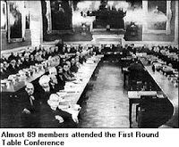
FIRST ROUND TABLE CONFERENCE(1930)
Princely States Representatives including Maharaja of Jammu and Kashmir, Nawab of Bhopal etc.

Slide 8
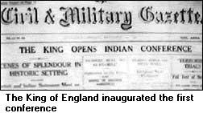
FIRST ROUND TABLE CONFERENCE(1930)
British-Indian Representatives include prominent figures of Muslim League (Muhammad Ali Jinnah, Agha Khan III, Maulana Muhammad Ali Jauhar etc) and other local minorities.
Congress did not participated in First RTC. Many of them were in Jail due to Civil Disobedience Movement (Gandhi, Nehru etc)

Slide 9
SUCCESS AND FAILURES OF FIRST ROUND TABLE CONFERENCE
SUCCESSES:
All the groups attending the conference supported the concept of an All- India Federation (federal Government) under British Government.
Princely States agreed also provided that their internal sovereignty was guaranteed.
The British Government agreed on Representative government on Provincial Level.

Slide 10
SUCCESS AND FAILURES OF FIRST ROUND TABLE CONFERENCE
All the ministries except Defense, Interior and Foreign Affairs will be given to local ministries.
FAILURE:
No consensus on the structure of Federation.
Majority party “Congress” boycotted the conference so there was no chance of acceptance of reforms in India.

Slide 11
SECOND ROUND TABLE CONFERENCE(1931)
Held in London in 7 September 1931.
Gandhi released from Jail.
Settlement between Gandhi and Lord Viceroy Irwin known as the “Gandhi-Irwin Pact”
Coalition Government in Britain with a Conservative Majority.
Participants:
There were mostly same participants as in RTC 1, but Congress attended the conference first time.

Slide 12
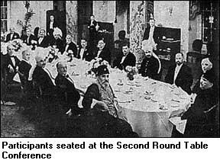
SECOND ROUND TABLE CONFERENCE(1931)
The discussion led to passing the Govt of India Act 1935.
Congress members included:
1. Mahatma Gandhi was the sole representative.
2. A. Rangaswami
3. Madan Mohan Malaviya.
Muslim League members included
1. Allama Iqbal
2. Agha Khan III
3. M A Jinnah

Slide 13
SUCCESS AND FAILURES OF SECOND ROUND TABLE CONFERENCE
SUCCESSES:
British declared Communal Award which ensured separate electorates having the consensus of minorities.
Successful for Muslims for 2 main Reasons
NWFP given full governor’s status.
Sindh to be separated from Bombay and to be made a separate province with a Governor.

Slide 14
SUCCESS AND FAILURES OF SECOND ROUND TABLE CONFERENCE
FAILURES:
Gandhi refused the demand of minorities for separate electorates and opposed it.
No plan was formed for the communal proportion by Minorities Committee.

Slide 15
THIRD ROUND TABLE CONFERENCE (1932)
The third RTC, held in London, begun in November 1932 and was ended in December 1932.
Congress was absent in this last RTC.
Labor Party also opposed this Conference.
Only forty-six delegates attended.

Slide 16
THIRD ROUND TABLE CONFERENCE
Few Muslim League members attended the conference which included Aga Khan III.
Congress refused to attend the last RTC and no member of Congress was present.

Slide 17
SUCCESS AND FAILURES OF THIRD ROUND TABLE CONFERENCE
SUCCESSES:
Basically, no new reforms or issue was created or passed in this last RTC.
The proposed reforms took the form reflected in Government of India Act 1935.

Slide 18
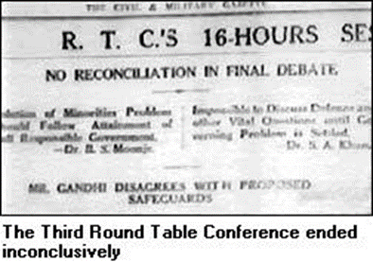
SUCCESS AND FAILURES OF THIRD ROUND TABLE CONFERENCE
FAILURES:
No solution for the pending disputes.
As congress boycotted, no reforms could be made in India without their involvement.
M A Jinnah was not invited to the Conference.

Slide 19
Conclusion of All Three Round Table Conferences
The main objective which was to develop consensus on constitutional reforms was not achieved.
Of all the conferences only 1st RTC was successful enough.
But due to these conferences, Federal form of Government was introduced, Provinces were given separate status, Communal award promised separate electorates and Sindh was separated from Bombay presidency.

Slide 20
THANK YOU !!!
Any Questions??

